Slide 1
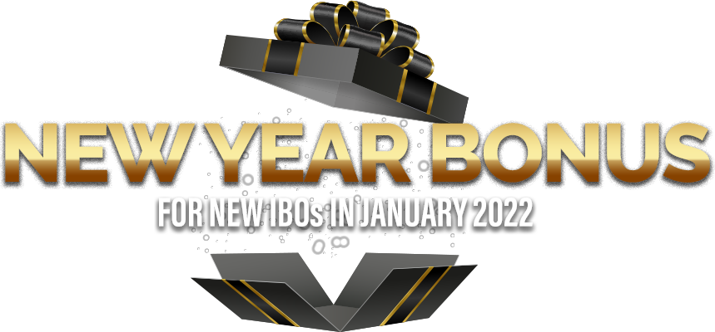
JANUARY
PROMOTIONS & REFERRAL PROGRAMS
+
January Customer Point Promotions………………2
IBO Bonus Promotion - XOOM ENERGY.……………….. 3
IBO Promotion – SPHERE.……………..........................................4
New ETLs Can Earn $700 or More! New Year BONUS in January....................5
Powerful Referral Programs ………………………. …………………………………7

Slide 2
January 2022 CUSTOMER Point Promotions*
We've increased the Customer Points in January for the acquisition of customers on select products.
 |  |  | January Promotion
GIG Plans 4GB & 10GB | 1 line | 2 points | 4 points
 | 2 lines | 3 points | 6 points
 | 3 lines | 4 points | 7 points
 | 4 lines | 5 points | 8 points
 | 5 lines | 6 points | 9 points
 | 6 lines | 7 points | 10 points
 |  | January Promotion
Quarterly Plan | 3 points | 4 points
Annual Plan | 4 points | 8 points
United States
 |  | January Promotion
Residential Electricity Service | 1 point | 2 points
United States & Canada
United States
 |  |  | January Promotion
Unlimited Plans 50GB & 75GB | 1 line | 3 points | 4 points
 | 2 lines | 4 points | 6 points
 | 3 lines | 5 points | 7 points
 | 4 lines | 6 points | 8 points
 |  | January Promotion
Flash High-Speed Internet | 2 points | 3 points
Canada
*Refer to the ACN Compensation Plan and the product-specific promotions for complete details.

Slide 3
United States & Canada
IBO Bonus Promotion
EARN $200 BONUS
&
GET DOUBLE POINTS
for New Residential Electricity Customers!
on Every 4 Customers You Refer to XOOM Energy!*
NO LIMIT
to the number of bonuses
you can EARN!
1
*Bonus Promotion Rules
1
Double Points Promotion Refer to ACN’s Compensation Plan for complete details.
Promotion runs January 1, 2022 – January 31, 2022. Enrollments received after this date do not qualify.
Customers who enroll from January 1, 2022 – January 31, 2022 must be in an active* status with XOOM Energy to qualify.
Residential, small business (online enrollments) and multi-location customers qualify for this promotion.
Big Business and Medium Business accounts are not eligible.
New customers only. Customers who have been active with XOOM Energy in the past 6 months do not qualify.
Current Stream Energy customers who switch to XOOM Energy do not qualify.
For US IBOs: Eligible customer accounts must be accepted by the utility and not in any hold status. This typically takes 2-3 business days.
For CA IBOs: Eligible customer accounts must be accepted by the utility and not in any hold status. This typically takes 2-3 business days in Alberta. Customers in Ontario must complete their third-party verification (TPV) process after their 10-day cooling-off period before it is submitted to the utility for approval.
Bonuses will be calculated starting on January 10, 2022 and weekly thereafter and will be paid by ACN starting on January 13, 2022. Calculations will then run weekly and paid by ACN weekly.
Enrollments entered during the promotional period must be in an active* status with XOOM Energy no later than March 7, 2022 to qualify. Any enrollments entered during the promotional period that become Active after March 7, 2022 will not qualify.
*Active - Eligible customer accounts must be accepted by the utility and not in any hold status. This typically takes 2-3 business days.

Slide 4
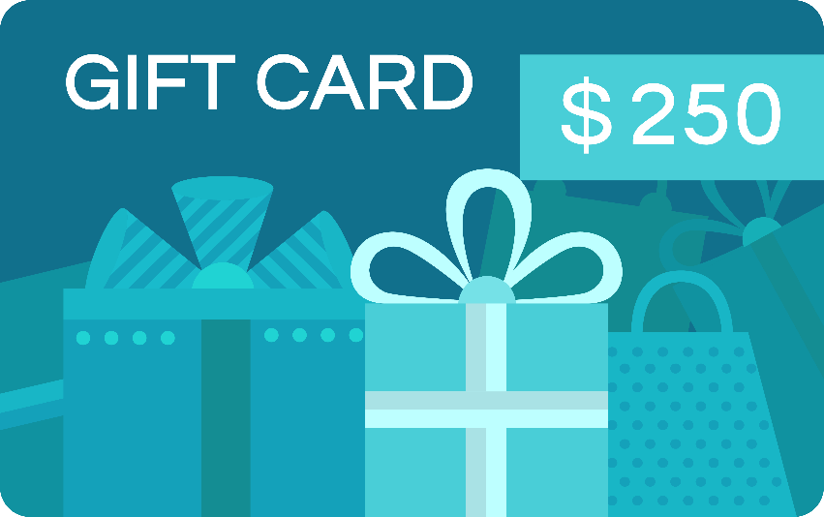
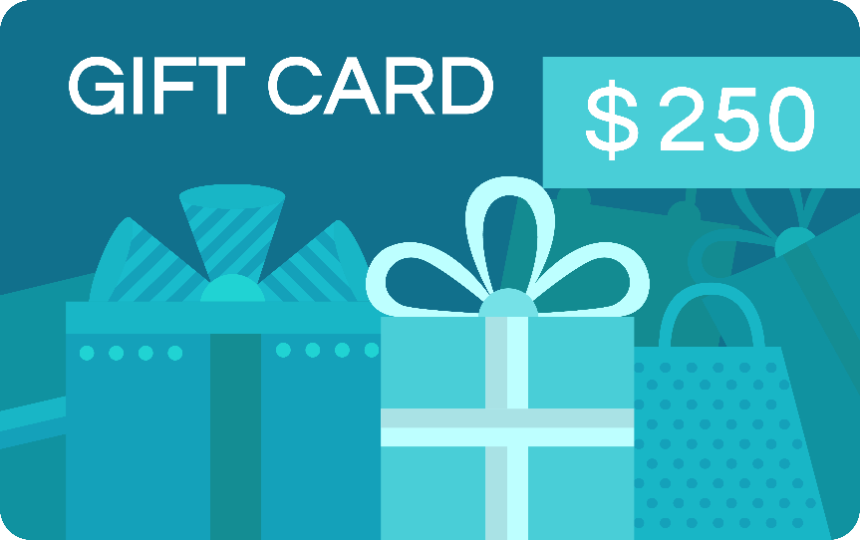
United States & Canada
IBO Promotion
Meet-or-Beat
Program
IBO
_{VISA}
IBO & Merchant each receive a $250 Visa Gift Card
if Sphere can't meet or beat the customer's current processing rate.*
Merchant
THIS IS A WIN-WIN!
_{VISA}
*A merchant currently accepting electronic payments, and processing more than $3,000 monthly can qualify for the Meet or Beat Pricing Opportunity provided merchant’s standard pricing is not below standard fees currently charged by Visa® and Mastercard®. This offer does not apply to existing customers. Certain restrictions and exclusions apply. Merchant account is subject to credit approval. Offer subject to change without notice. Price comparison applies to processing rates and fees only, not to include monthly terminal and software fees. Merchants must provide their 2 most recent credit card processing statements and complete the Pricing Request form. Offer expires 60 days after receipt of application. Excludes high-risk merchants such as, but not limited to, travel, digital content or virtual goods, adult entertainment, online nutritional supplements, membership subscriptions, ticketing, national, and franchises. Qualifying recipients will receive prepaid gift card via mail within 45 days.

Slide 5
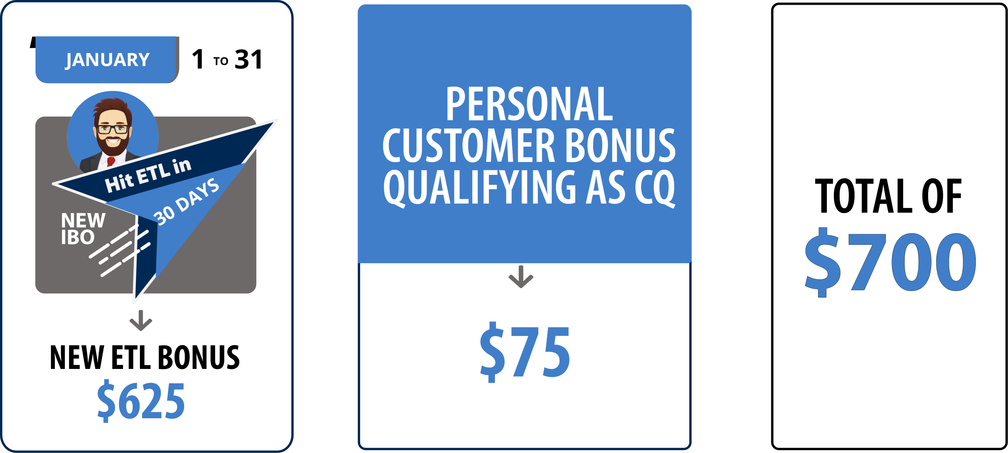
NEW ETL in 30 DAYS BONUS
New Year Bonus January*
New IBO Bonus Qualifications
New US/CA IBOs with a start date in January are eligible
Reach ETL in their first 30 days with a minimum of 15 points from their downline, receive a $625 Bonus
This Bonus is in addition to the $75 Personal Customer Bonus
*Refer to the ACN Compensation Plan for complete details.

Slide 6
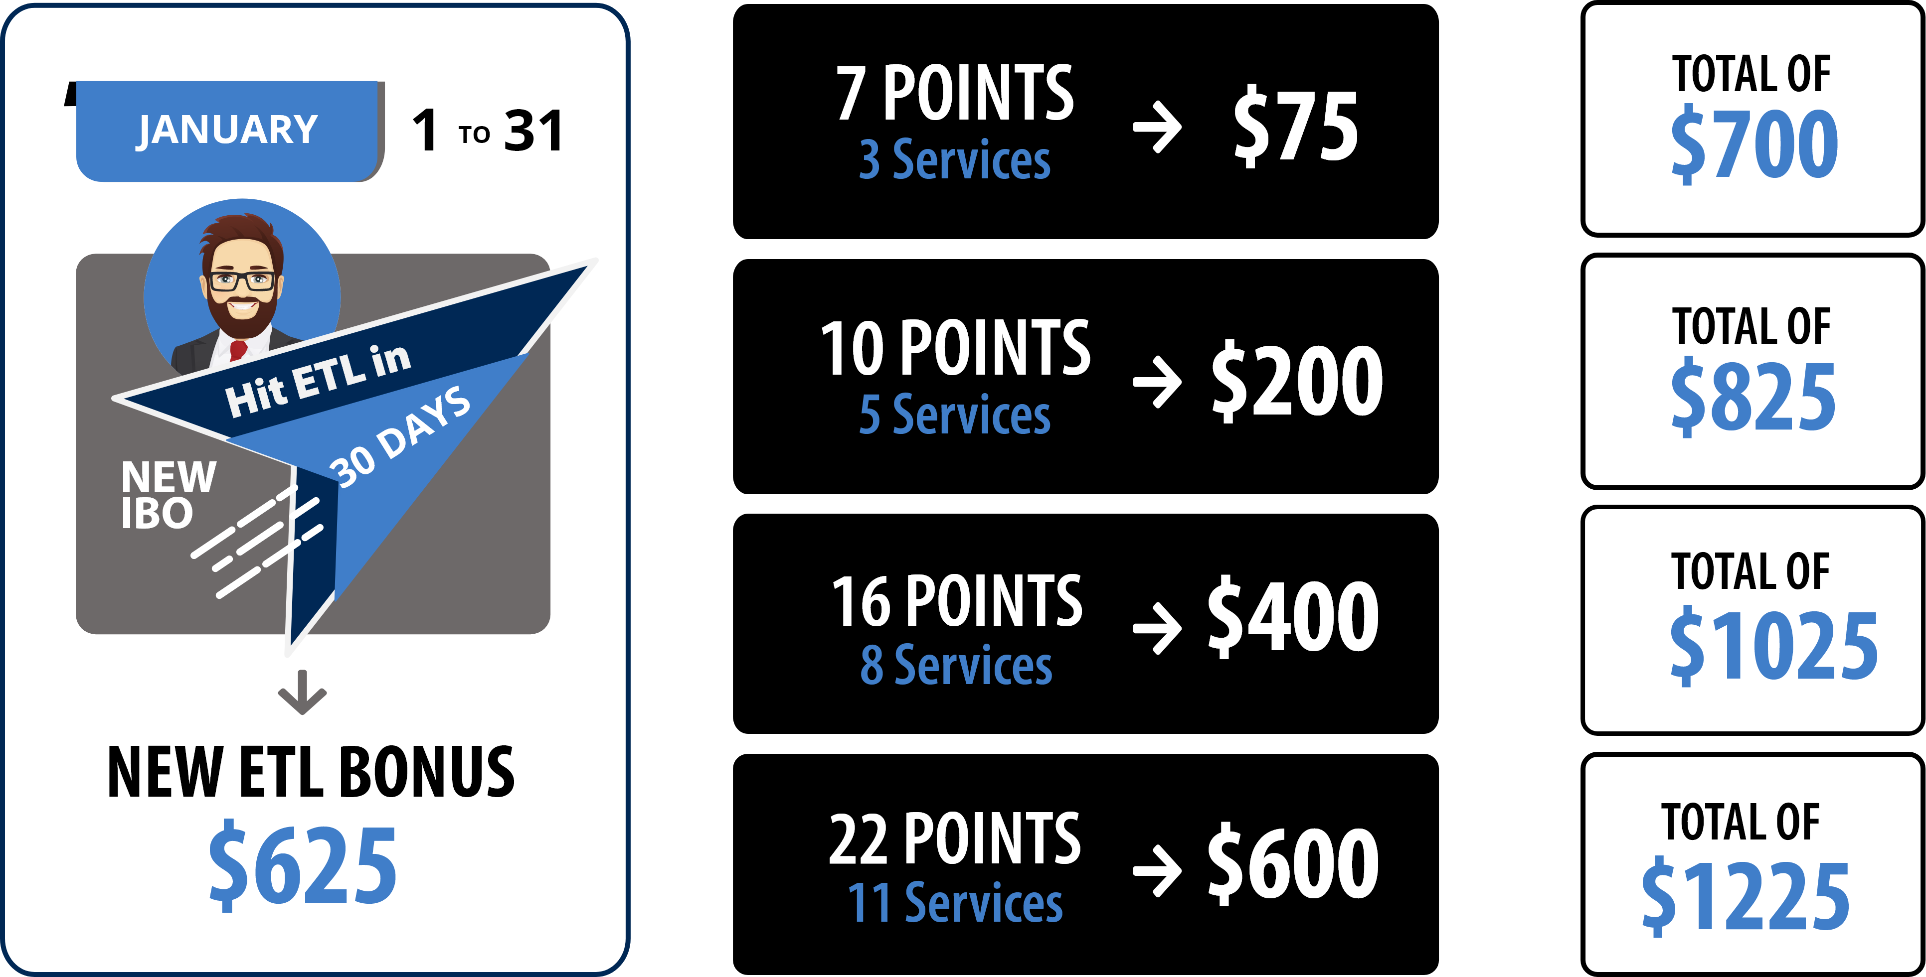
NEW ETL IN 30 DAYS BONUS* POTENTIAL
New IBOs with a start date in January who personally acquire more customers in their first 30 days and earn the higher monthly personal customer bonuses
when combined with the
NEW ETL in 30 days
New Year Bonus in January can earn:
Qualify as an ETL in
30 Days with at least
15 downline
customer points.
*Refer to the ACN Compensation Plan for complete details.

Slide 7
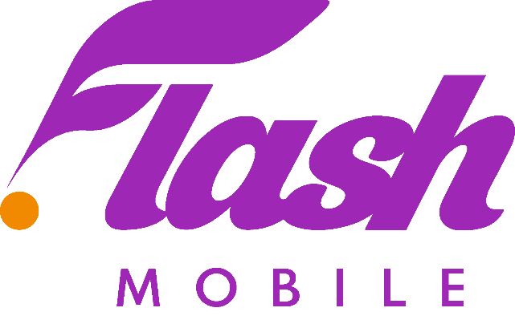
Powerful Referral programs
IBO Only Referral Program
IBO Only Referral Program
GET 5,
GET REWARDED* Receive a BONUS equal to the cost of your Quarterly or Annual IDSeal Subscription
z
GET 5, GET FREE* Earn a FREE line of service on your personal account for every 5 Flash Mobile accounts acquired.*
United States Only
IBO Only Referral Program
IBO & Customer Referral Programs
PowerUP* Refer 12+ Residential Natural Gas or 12+ Residential Electricity customers and receive a BONUS equal to the average commodity charges.
GET 5, GET FREE* Earn a FREE service for every 5 Flash Services Internet or Internet + Home Phone customers.*
BONUSES* and FREE* service earned monthly as long as your customers stay.
* Refer to acncompass.com and the product-specific program for terms and conditions and complete details.

