Slide 2
Why TELUS?

Slide 3
Why TELUS?

Slide 4
Why TELUS?

Slide 5
TELUS Plans & Programs Overview

Slide 6
Key Things To Note

Slide 12
The Customer Order Process

Slide 13
The Customer Order Process

Slide 14
The Customer Order Process

Slide 15
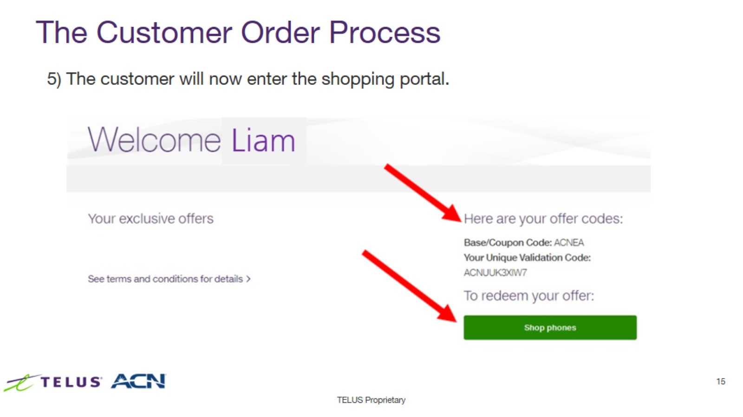
The Customer Order Process

Slide 16
The Customer Order Process

Slide 17
The Customer Order Process

