Slide 1
FOR NEW IBOs IN MAY 2022
New ETLs Can Earn $500 or More!
FAST START BONUS in May.........4-5
May Customer Point Promotions .........2
IBO Promotion – Sphere .......................3
Powerful Referral Programs ..................6

Slide 2
May 2022 CUSTOMER Point Promotions*
We've increased the Customer Points in May for the acquisition of customers on select products.
 |  | May Promotion
Annual Plan | 4 points | 8 points
 |  |  | May Promotion
GIG Plans 4GB & 10GB | 1 line | 2 points | 4 points
 | 2 lines | 3 points | 6 points
 | 3 lines | 4 points | 7 points
 | 4 lines | 5 points | 8 points
 | 5 lines | 6 points | 9 points
 | 6 lines | 7 points | 10 points
United States
 |  | May Promotion
Residential Electricity Service | 1 point | 2 points
United States & Canada
 |  | May Promotion
Flash High-Speed Internet | 2 points | 3 points
United States
 |  |  | May Promotion
Unlimited Plans 50GB & 75GB | 1 line | 3 points | 4 points
 | 2 lines | 4 points | 6 points
 | 3 lines | 5 points | 7 points
 | 4 lines | 6 points | 8 points
Canada
 |  | May Promotion
Security & Automation | 5 points | 8 points
Canada
*Refer to the ACN Compensation Plan and the product-specific promotions for complete details.

Slide 3
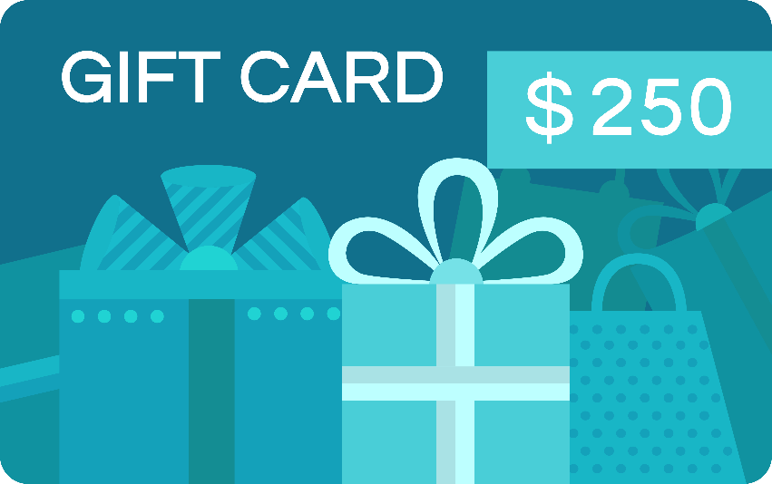
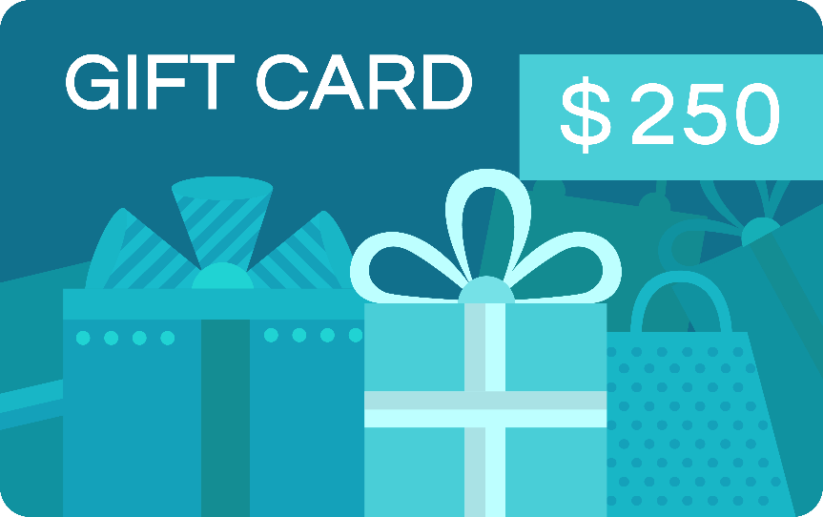
IBO Promotion
United States & Canada
Meet-or-Beat
Program
IBO
_{VISA}
IBO & Merchant each receive a $250 Visa Gift Card
if Sphere can't meet or beat the customer's current processing rate.*
Merchant
THIS IS A WIN-WIN!
_{VISA}
*A merchant currently accepting electronic payments, and processing more than $4,000 monthly can qualify for the Meet or Beat Pricing Opportunity provided merchant’s standard pricing is not below standard fees currently charged by Visa® and Mastercard®. This offer does not apply to existing customers. Certain restrictions and exclusions apply. Merchant account is subject to credit approval. Offer subject to change without notice. Price comparison applies to processing rates and fees only, not to include monthly terminal and software fees. Merchants must provide their 2 most recent credit card processing statements and complete the Pricing Request form. Offer expires 60 days after receipt of application. Excludes high-risk merchants such as, but not limited to, travel, digital content or virtual goods, adult entertainment, online nutritional supplements, membership subscriptions, ticketing, national, and franchises. Qualifying recipients will receive prepaid gift card via mail within 45 days.

Slide 4
NEW ETL in 30 DAYS BONUS
Fast Start Bonus May*
New IBO Bonus Qualifications
FOR NEW IBOs IN MAY 2022
New US/CA IBOs with a start date in May are eligible
Reach ETL in their first 30 days with a minimum of 15 points from their downline, receive a $425 Bonus
This Bonus is in addition to the $75 Personal Customer Bonus
*Refer to the ACN Compensation Plan for complete details.

Slide 5
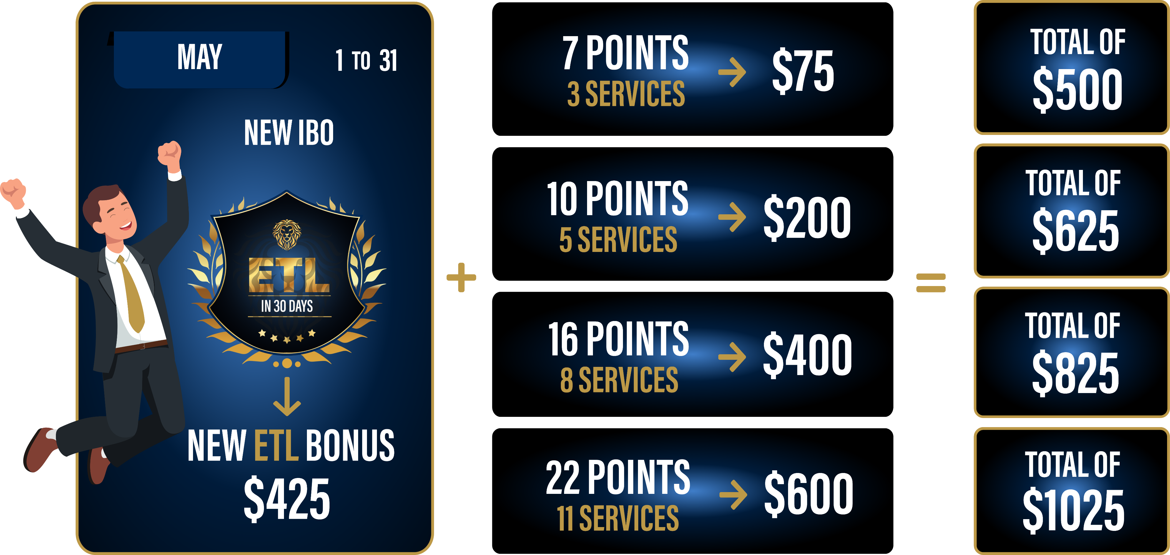
NEW ETL IN 30 DAYS BONUS* POTENTIAL
FOR NEW IBOs IN MAY 2022
New IBOs with a start date in May who personally acquire more customers in their first 30 days and earn the higher monthly personal customer bonuses when combined with the NEW ETL in 30 days
Fast Start Bonus in May can earn:
Qualify as an ETL in
30 Days with at least
15 downline
customer points.
*Refer to the ACN Compensation Plan for complete details.

Slide 6
Powerful Referral programs
IBO Only Referral Program
IBO Only Referral Program
GET 5,
GET REWARDED* Receive a BONUS equal to the cost of your Quarterly or Annual IDSeal Subscription
z
GET 5, GET FREE* Earn a FREE line of service on your personal account for every 5 Flash Mobile accounts acquired.*
United States Only
IBO Only Referral Program
IBO & Customer Referral Programs
PowerUP* Refer 12+ Residential Natural Gas or 12+ Residential Electricity customers and receive a BONUS equal to the average commodity charges.
GET 5, GET FREE* Earn a FREE service for every 5 Flash Services Internet or Internet + Home Phone customers.*
BONUSES* and FREE* service earned monthly as long as your customers stay.
* Refer to acncompass.com and the product-specific program for terms and conditions and complete details.

