Slide 1
June Customer Point Promotions .........2
IBO Promotion – Sphere ....................3-4
IBO Promotion – Vivint .........................5
IBO Promotion – Xoom .........................6
Powerful Referral Programs ...................9
New ETLs Can Earn $500 or More!
FAST START BONUS in June .........7-8
FOR NEW IBOs IN JUNE 2022

Slide 2
JUNE 2022 CUSTOMER Point Promotions*
We've increased the Customer Points in June for the acquisition of customers on select products.
 |  | June Promotion
Annual Plan | 4 points | 8 points
 |  |  | June Promotion
GIG Plans 4GB & 10GB | 1 line | 2 points | 4 points
 | 2 lines | 3 points | 6 points
 | 3 lines | 4 points | 7 points
 | 4 lines | 5 points | 8 points
 | 5 lines | 6 points | 9 points
 | 6 lines | 7 points | 10 points
United States
 |  | June Promotion
Residential Electricity Service | 1 point | 2 points
United States & Canada
 |  | June Promotion
Flash High-Speed Internet | 2 points | 3 points
United States
 |  |  | June Promotion
Unlimited Plans 50GB & 75GB | 1 line | 3 points | 4 points
 | 2 lines | 4 points | 6 points
 | 3 lines | 5 points | 7 points
 | 4 lines | 6 points | 8 points
Canada
 |  | June Promotion
Frontier High-Speed Internet | 2 points | 3 points
United States
*Refer to the ACN Compensation Plan and the product-specific promotions for complete details.

Slide 3
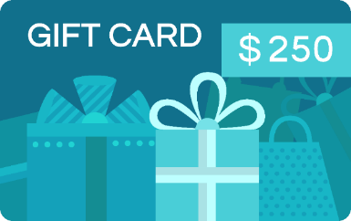
IBO Promotion
United States & Canada
Meet-or-Beat
Program
IBO
_{VISA}
IBO & Merchant each receive a $250 Visa Gift Card
if Sphere can't meet or beat the customer's current processing rate.*
Merchant
THIS IS A WIN-WIN!
_{VISA}
*A merchant currently accepting electronic payments, and processing more than $4,000 monthly can qualify for the Meet or Beat Pricing Opportunity provided merchant’s standard pricing is not below standard fees currently charged by Visa® and Mastercard®. This offer does not apply to existing customers. Certain restrictions and exclusions apply. Merchant account is subject to credit approval. Offer subject to change without notice. Price comparison applies to processing rates and fees only, not to include monthly terminal and software fees. Merchants must provide their 2 most recent credit card processing statements and complete the Pricing Request form. Offer expires 60 days after receipt of application. Excludes high-risk merchants such as, but not limited to, travel, digital content or virtual goods, adult entertainment, online nutritional supplements, membership subscriptions, ticketing, national, and franchises. Qualifying recipients will receive prepaid gift card via mail within 45 days.

Slide 4
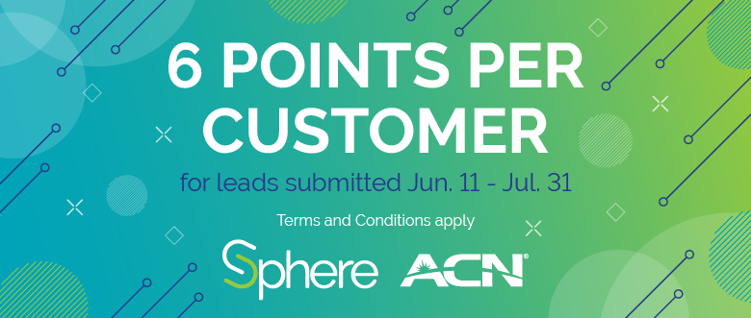
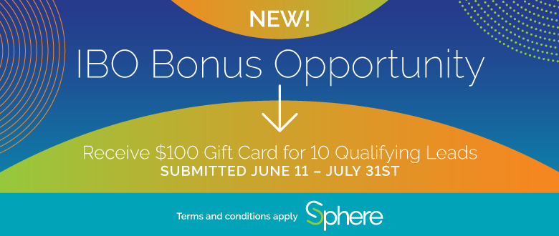
IBO Promotion
United States & Canada
DOUBLE POINT PROMO and $100 IBO Bonus,
STARTS ON JUNE 11
TERMS AND CONDITIONS
Merchant leads must be submitted between June 11, 2022 and July 31, 2022, and be in an activation status by August 31, 2022.
To qualify, a merchant must be currently processing more than $4,000 monthly.
IBOs will be paid in accordance with ACN policies and procedures.
All accounts subject to credit approval; some restrictions and exclusions apply to all offerings.
This offer cannot be combined with any other offer. offer valid for ACN IBOs only.
Sphere reserves the right to change the terms and conditions of this offer or to terminate this offer at any time in its sole and absolute discretion.
TERMS AND CONDITIONS
Each lead must already be processing, must include processing statement, must process greater than $4,000 monthly.
This offer cannot be combined with any other offer.
Offer valid for ACN IBOs only.
Sphere reserves the right to change the terms and conditions of this offer or to terminate this offer at any time in its sole and absolute discretion.

Slide 5
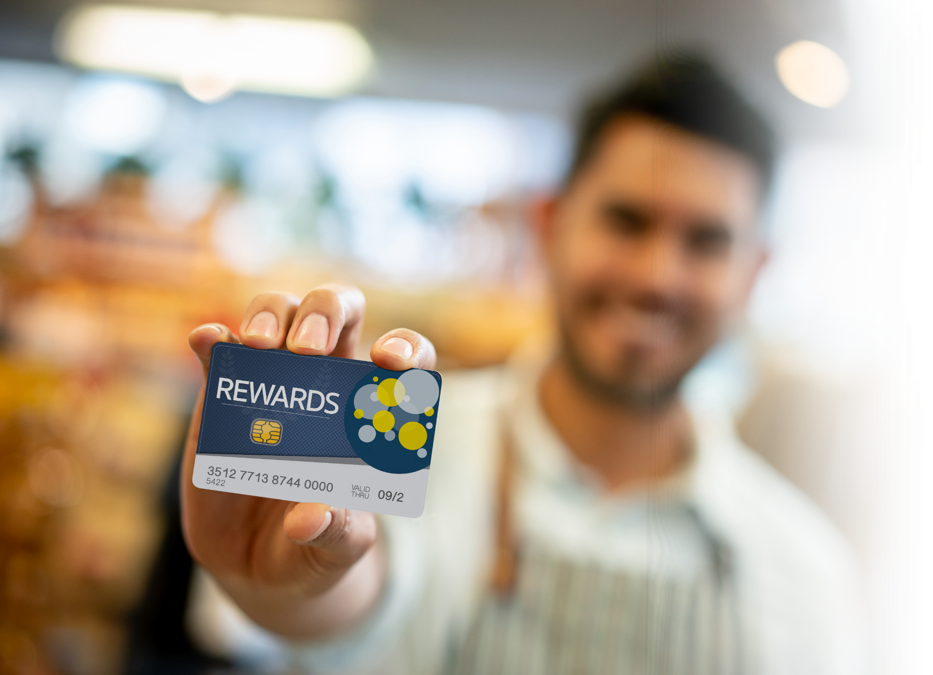
IBO Promotion
United States & Canada
June 1 - June 30
For every Vivint customer order from June 1 to June 30, an IBO will receive a a $100 Visa Reward Card
_{VISA}
₂

Slide 6
IBO Promotion
United States & Canada
EARN $200 BONUS
FOR EVERY 5 NEW ENERGY CUSTOMERS YOU REFER
JUNE 1 – 30, 2022
Conditions Apply*
• Promotion runs June 1, 2022 – June 30, 2022. Enrollments received after this date do not qualify.
• Customers who enroll from June 1, 2022 – June 30, 2022, must be in an active* status with XOOM Energy to qualify.
• Residential, small business (online enrollments) and multi-location customers qualify for this promotion. (WEB & MLE included)
• Big Business and Medium Business accounts are not eligible. (BBP & MTB excluded)
• New customers only. Customers who have been active with XOOM Energy in the past 6 months do not qualify.
• Current Stream Energy customers who switch to XOOM Energy do not qualify.
• Bonuses will be calculated starting on June 13, 2022, and weekly thereafter and will be paid by ACN starting on June 16, 2022. Calculations will then run weekly and paid by ACN weekly.
• Enrollments entered during the promotional period must be in an active* status with XOOM Energy no later than July 5, 2022, to qualify. Any enrollments entered during the promotional period that become Active after July 5, 2022, will not qualify. *Active – Eligible customer accounts must be accepted by the utility and not in any hold status. This typically takes 2-3 business days.
For Canada only: Eligible customer accounts must be accepted by the utility and not in any hold status. This typically takes 2-3 business days in Alberta. Customers in Ontario must complete their third-party verification (TPV) process after their 10-day cooling-off period before it is submitted to the utility for approval.

Slide 7
NEW ETL in 30 DAYS BONUS
Fast Start Bonus June*
New IBO Bonus Qualifications
New US/CA IBOs with a start date in June are eligible
Reach ETL in their first 30 days with a minimum of 15 points from their downline, receive a $425 Bonus
This Bonus is in addition to the $75 Personal Customer Bonus
*Refer to the ACN Compensation Plan for complete details.

Slide 8
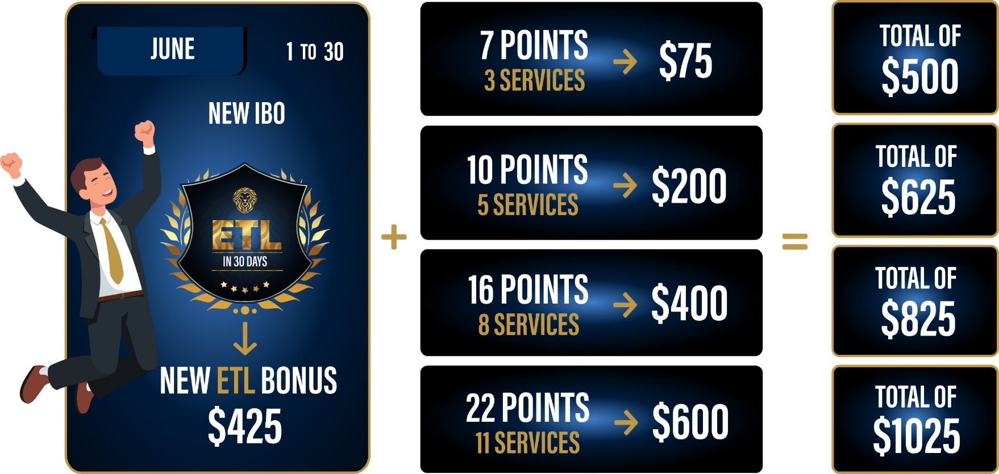
NEW ETL IN 30 DAYS BONUS* POTENTIAL
New IBOs with a start date in June who personally acquire more customers in their first 30 days and earn the higher monthly personal customer bonuses when combined with the NEW ETL in 30 days
Fast Start Bonus in June can earn:
Qualify as an ETL in
30 Days with at least
15 downline
customer points.
*Refer to the ACN Compensation Plan for complete details.

Slide 9
Powerful Referral programs
IBO Only Referral Program
Refer a Friend* Receive a BONUS equivalent to the cost of your Quarterly or Annual IDSeal Subscription
z
IBO Only Referral Program
United States Only
Refer a Friend* Earn a FREE line of service on your personal account for every 5 Flash Mobile accounts acquired.*
Refer a Friend* Receive a CREDIT equivalent to the cost of your Quarterly or Annual IDSeal Titan Subscription
z
Canada Only
IBO & Customer Referral Programs
PowerUP* Refer 12+ Residential Natural Gas or 12+ Residential Electricity customers and receive a BONUS equal to the average commodity charges.
Refer a Friend* Earn a FREE service for every 5 Flash Services Internet or Internet + Home Phone customers.*
BONUSES* and FREE* service earned monthly as long as your customers stay.
* Refer to acncompass.com and the product-specific program for terms and conditions and complete details.

